Slide 1

KARANG: overcoming market failures in the blue economy through dynamic supply and demand aggregation
Kat Leigh
3/4/2023

Slide 2
Summary
The world’s coasts generate 68% of global GDP, and are home to 40% of the Earth’s population; and seafood alone provides 20% of protein intake globally, and over 70% for some communities.
Yet, our blue economy is rife with market failures that not only exacerbate natural problems, but produce man-made threats, too.
This project aims to:
Construct a theoretical model of a potential solution for the market failures of our blue economy
Conduct a lab-based experiment to empirically validate this theoretical model
This model will build upon existing economic research on the topics of:
Moral hazard and adverse selection contract formation
Optimal contract design for threshold public goods
Network theory.

Slide 3
Motivation: sustain the economic value of our blue economy
Our coastal industries and communities face complex and increasingly growing threats
Information can help coastal stakeholders combat these threats but…
Major market failures stand in the way.
For a single entity, acquiring this information:
Is costly
Is time-consuming
Requires expertise
Has an ROI that is too low (marginal gain < necessary marginal effort)
In aggregate, these barriers are trivial, yet no efficient system exists for aggregation.
Creating a system for dynamic aggregation of dilute supply and demand can empower coastal stakeholders to overcome these market failures, and thrive.

Slide 4
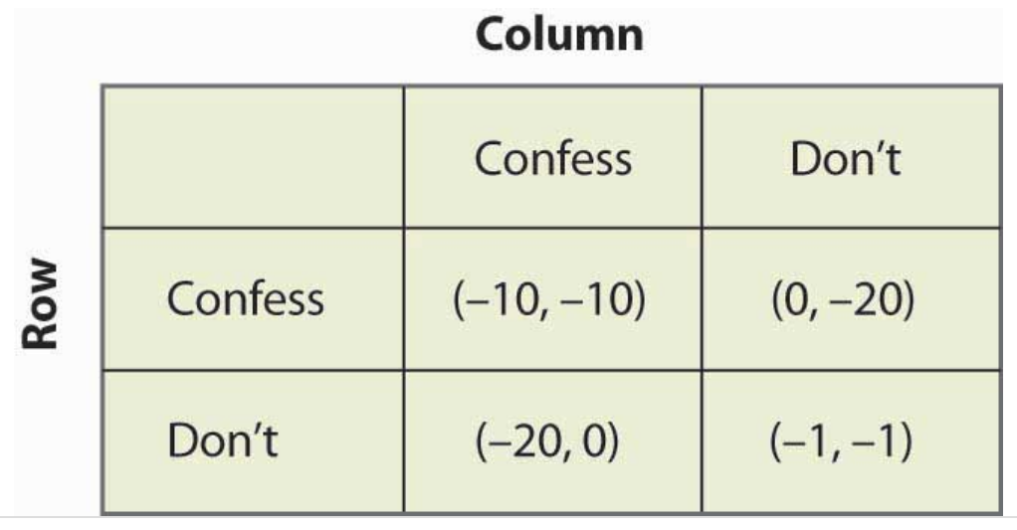

Background
Game theory → contract theory
Constrained optimization
i,j: agent’s type, t: transfer, q: quantity produced by agent, c: agent’s cost e: agent’s effort, U: principal’s utility, ∏: agent’s profit
Adverse selection (inability to verify agent TYPE) → impersonation possible
Moral hazard (inability to verify agent EFFORT) → shirking possible
Threshold public goods
Goods that benefit multiple parties, whose realization is contingent upon reaching a threshold
Dilute supply & demand (inverse of economies of scale)
$$\max\left\{ U\left(q\left(e\right)\right)−t \right\} s.t. \\ \text{I}\text{.}\text{R}\text{.: }π_{i}\left(t_{i}−{c_{i}(e}_{i})\right)≥0 \\ \text{I}\text{.}\text{C}\text{.:} π_{i}\left(t_{i}−{c_{i}(e}_{i})\right)≥π_{i}\left(t_{j}−{c_{i}(e}_{j})\right)$$

Slide 5
Previous Research
The general theory of common agency under adverse selection¹ has been widely studied, especially with respect to the problem of costly repayment enforcement in the case of one principal and one agent². But, little attention has been paid to the strategic interactions between multiple principals and one agent.
inefficiency in rent extraction arises, and contractual externalities depend on whether the contracting activity controlled by one principal affects directly or not the utility function of competing mechanism designers.³
Transaction costs that prevent comprehensive and cooperative contracting have a significant impact on the shapes of observed financial contracts. (consider the stark discrepancies in data availability and quality between developed and developing ocean communities.)
Importantly, costs arise not just from the cost of monitoring, but also from contractual externalities. Investors do not have incentive to take into account the impact of the various elements of their lending relationship (level and structure of investment, monitoring, and exercise of control rights) on the returns of the other investors. ⁵
In a moral hazard setting, indebtedness is higher than if the agent could only borrow from one principal.
In the case of centralized monitoring and coordinated contracting, contracts are optimal for all parties.
However, with centralized monitoring and uncoordinated contracts, each principal derives a positive externality from the other principal’s contract, so excessive monitoring arises.
Without centralized monitoring and with uncoordinated contracts, free riding between principals leads to a collapse of monitoring for high profit levels.³
Our blue economy lacks both centralized monitoring and contract coordination in countless contexts.
These issues are compounded by the complications around optimal contract formation for threshold public goods.
Notes:
1. Applications already span several fields. Laffont and Tirole [19] analyze regulation; Martimort [22,23], Mezzetti [26] and Stole [36] deal with nonlinear pricing and manufacturer–retailer relationships; Biais et al. [3] study competing marketmakers in financial markets. Martimort and Stole [24] and Peters [29,30] offer theoretical frameworks to understand what are the natural classes of mechanisms to be studied. For models of common agency under moral hazard, see Bernheim and Whinston [1,2] among others.
2. See, for example, the classic pieces Townsend [39], Gale and Hellwig [13], and Border and Sobel [6]
3. For instance, Martimort and Stole [25] analyze a common retailer–manufacturer example. See also the more abstract framework of Peters [30] who stresses the role of direct externalities between the principal on the kind of mechanisms which can be used. Segal [33] offers a framework for dealing with contractual externalities under complete information but reverses the role of the principal and the agents.
4. See, for example, Schleifer and Vishny [34] and Pagano and Röell [27].
5. See, for example, Townsend [39], Gale and Hellwig [13], Freixas and Rochet [12], and Tirole [38].
6. Dewatripont and Maskin [10].
7. 16, 31, 9, 5, 10.
8. 8
7. See Khalil 2007.

Slide 6
Objectives
Design a novel solution to address the market failures of dilute supply and demand for threshold quasi-public goods that can serve as the foundation for a thriving, truly sustainable blue economy.
Transparent, traceable, and immutable transactions
Dynamic, responsive, inclusive, and accessible system
Automated verification & enforcement of user-specified contracts
Realignment of economic activity to be in sync with the environment (upon which –ultimately– it fully depends)

Slide 7
Tasks
Formally develop a theoretical model of the KARANG concept that incorporates adverse selection and moral hazard on both the demand and supply side.
Construct a demand-side model where multiple principals benefit from the outputs of multiple threshold quasi-public projects
Construct a supply-side model based on multiple agents who contribute towards the completion of multiple threshold quasi-public projects
Construct a bridging mechanism which connects the supply and demand side models together
Conduct a lab-based simulation in order to empirically validate the model under a controlled setting.
Design a lab experiment that emulates the interactions and incentive structures built into the theoretical model
Solicit human participants who will take part in the experiment
Execute a sufficient number of experimental trials, analyze the results, and compare with the expected results predicted by the theoretical model

Slide 8
1. Theoretical model of the KARANG concept
Project 2
Agent e
Agent f
Project 2
Principal D
Step 2
Step 1
Project 1
Agent a
Agent b
Agent c
Agent d
Project 1
Principal A
Principal B
Principal C
Step 3

Slide 9
Project 2
Agent e
Agent f
Project 2
Principal D
Supply-side
Demand-side
Project 1
Agent a
Agent b
Agent c
Agent d
Project 1
Principal A
Principal B
Principal C
Bridging mechanism

Slide 10





2. lab-based simulation for empirical validation
Conduct, analyze, compare
2. Acquire participants
1. Design

Slide 11
Timeline & Budget
Spring / Summer 2023
Develop demand model
2024
Develop supply model
Develop bridge mechanism
2025
Acquire participants
Conduct experimental trials
Design empirical study
Analyze results & compare with theoretical predictions
Write potential academic paper on demand model
Write blog about demand model
Write potential academic paper on supply model
Write blog about supply model
Summer 2024
Write blog about overarching model
Summer 2025
Write blog about empirical findings
Write academic paper on overarching model
Write potential empirical paper
Item | Amount
Model development | $4,500
Participant acquisition | $1,000
Execution of experimental trials (includes participant compensation) | $3,000
Analysis & comparison | $1,000
Publication fees | $1,500
Total: | $11,000

Slide 12
Questions?
Construct a theoretical model of a potential solution for the market failures (dilute supply and demand for threshold quasi-public goods) of our blue economy
by building upon existing economic research on the topics of:
Moral hazard and adverse selection contract formation
Optimal contract design for threshold public goods
Network theory.
Conduct a lab-based experiment to empirically validate this theoretical model
Ultimately, provide a foundation for a thriving, truly sustainable blue economy.
Thank you!

Slide 13
Previous Research
The general theory of common agency under adverse selection¹ has been widely studied, especially with respect to the problem of costly repayment enforcement in the case of one principal and one agent². But, little attention has been paid to the strategic interactions between multiple principals and one agent.
In such contexts, inefficiency in rent extraction arises, and contractual externalities depend on whether the contracting activity controlled by one principal affects directly or not the utility function of competing mechanism designers.³
In privately held companies or when financiers (principals) provide lots of funds, each principal has the incentive and the skills to independently affect the income they extract from agents through monitoring as well as transfers.⁴ (consider how prolific grant-funding is in ocean science/conservation)
Transaction costs that prevent comprehensive and cooperative contracting have a significant impact on the shapes of observed financial contracts. (consider the stark discrepancies in data availability and quality between developed and developing ocean communities.)
Importantly, costs arise not just from the cost of monitoring, but also from contractual externalities. Investors do not have incentive to take into account the impact of the various elements of their lending relationship (level and structure of investment, monitoring, and exercise of control rights) on the returns of the other investors. ⁵
Agents end up being financed by more than one principal for a variety of reasons: lenders may simply be resource constrained⁶, there could be several strategic advantages related to information, or this may result from the trade-off between the costs of effort duplication and sharing of monitoring benefits on the one hand, and the benefit from the diseconomies of scale in monitoring each principal faces when monitoring alone on the other hand^{8.}
In a moral hazard setting, when agents borrow from several principals, indebtedness is higher than if the agent could only borrow from one principal.
Khalil 2007 focuses on contexts where multiple principals attempt to obtain income from a privately informed agent, such as in the case of multiple financiers.
In the case of centralized monitoring and coordinated contracting, contracts are optimal for all parties.
However, with centralized monitoring and uncoordinated contracts, each principal derives a positive externality from the other principal’s contract, so excessive monitoring arises.
Without centralized monitoring and with uncoordinated contracts, free riding between principals leads to a collapse of monitoring for high profit levels.³
Our blue economy lacks both centralized monitoring and contract coordination in countless contexts.
These issues are compounded by the complications around optimal contract formation for threshold public goods.
Notes:
1. Applications already span several fields. Laffont and Tirole [19] analyze regulation; Martimort [22,23], Mezzetti [26] and Stole [36] deal with nonlinear pricing and manufacturer–retailer relationships; Biais et al. [3] study competing marketmakers in financial markets. Martimort and Stole [24] and Peters [29,30] offer theoretical frameworks to understand what are the natural classes of mechanisms to be studied. For models of common agency under moral hazard, see Bernheim and Whinston [1,2] among others.
2. See, for example, the classic pieces Townsend [39], Gale and Hellwig [13], and Border and Sobel [6]
3. For instance, Martimort and Stole [25] analyze a common retailer–manufacturer example. See also the more abstract framework of Peters [30] who stresses the role of direct externalities between the principal on the kind of mechanisms which can be used. Segal [33] offers a framework for dealing with contractual externalities under complete information but reverses the role of the principal and the agents.
4. See, for example, Schleifer and Vishny [34] and Pagano and Röell [27].
5. See, for example, Townsend [39], Gale and Hellwig [13], Freixas and Rochet [12], and Tirole [38].
6. Dewatripont and Maskin [10].
7. 16, 31, 9, 5, 10.
8. 8
7. See Khalil 2007.

